Slide 1
Self Assessment Tool
8th and 9th March 2022
FDC

Slide 2
Acknowledgment of Country
We acknowledge the traditional owners of the land where we reside and work in paying respects to the first people on whose land we are, acknowledging the loss of lands, cultures and treasures, knowing the consequences for people, communities and nations, believing that we can work together to a better future

Slide 3
Agenda
What is a Self assessment tool?
How is it related to service’s Quality improvement plan.
Why is it important to self assess programs and practices
Reflective questions covering eac element and some examples to support assessment.
Questions.

Slide 4
Self Assessment tool- what is it?
The Self-assessment Tool developed by Acecqa will support approved providers, service leaders and educators to reflect on and better understand their current practices and identify opportunities for improving quality outcomes for children and families.
A commitment to continuous improvement is inherent in the National Quality Framework (NQF) and striving for best practice underpins this commitment.
When all staff and educators of an education and care service understand what is guiding their practice, they can work together for continuous quality improvements to enhance outcomes for children.

Slide 5
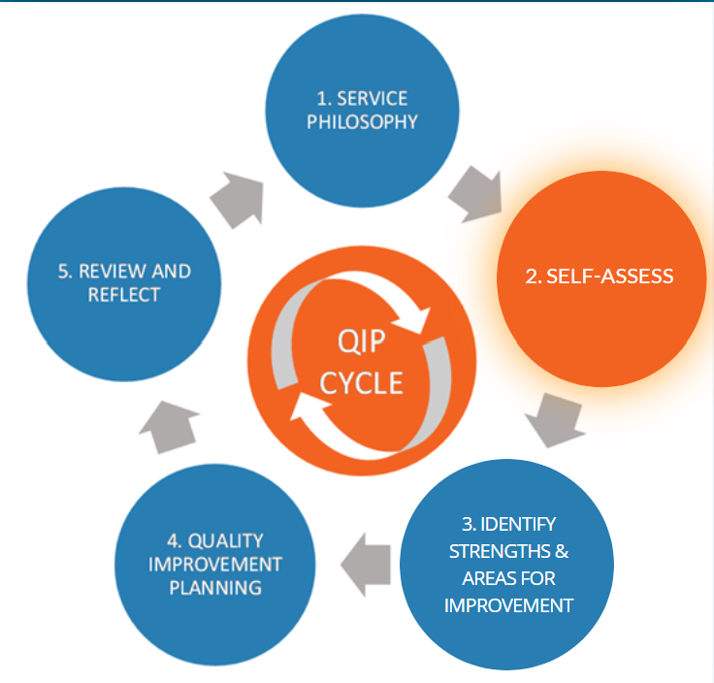
Self Assessment and QIP
Self-assessment is an important part of the quality improvement planning process. NQS Element 7.2.1 requires an effective self-assessment and quality improvement process to be in place.
The Self-assessment Tool will help us identify service strengths, areas of compliance, practices that are Exceeding NQS, and areas and opportunities for quality improvement. The Tool helps through the process of self-assessment which can, where needed, inform service’s QIP.
Documenting the self assessment process will demonstrate that your service has completed it and shows how the process has informed your QIP.

Slide 6
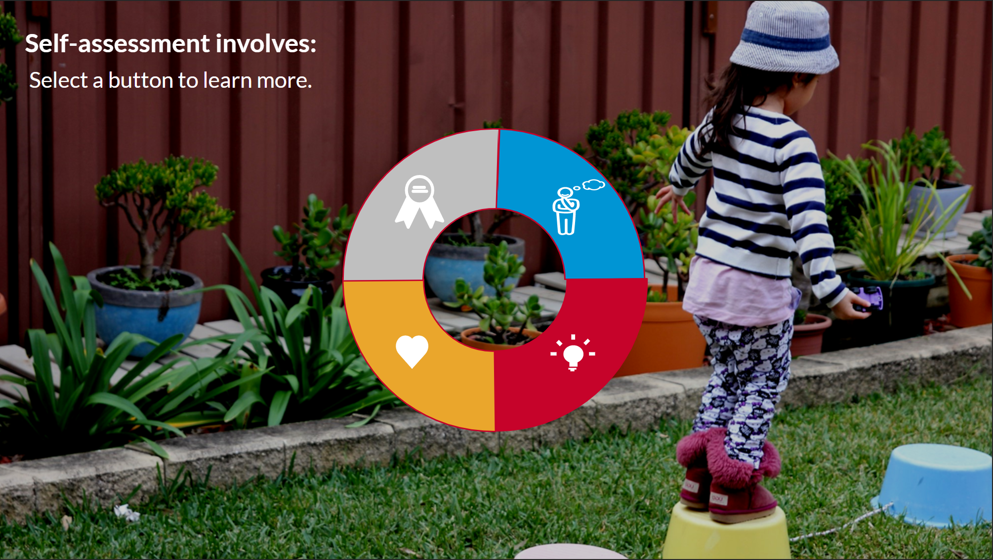
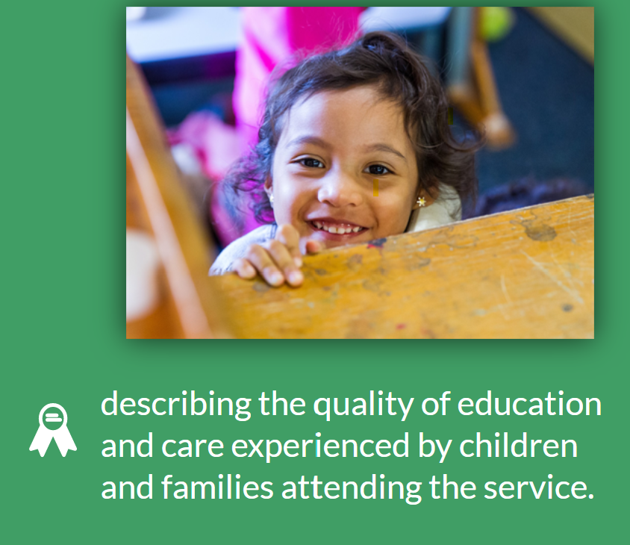
Self Assessment- what's in it?
Notes:
We have a very experienced marketing team that can provided marketing assistance

Slide 7
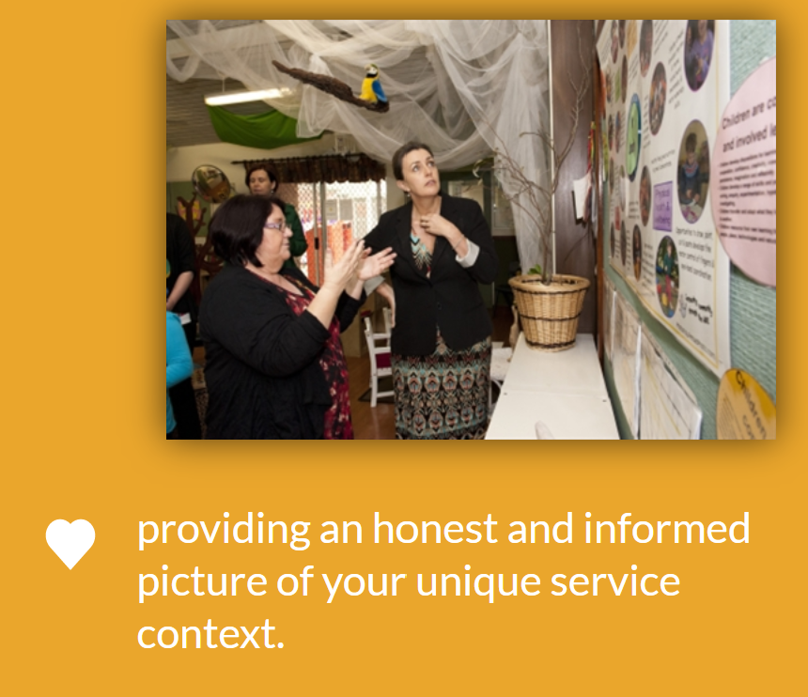
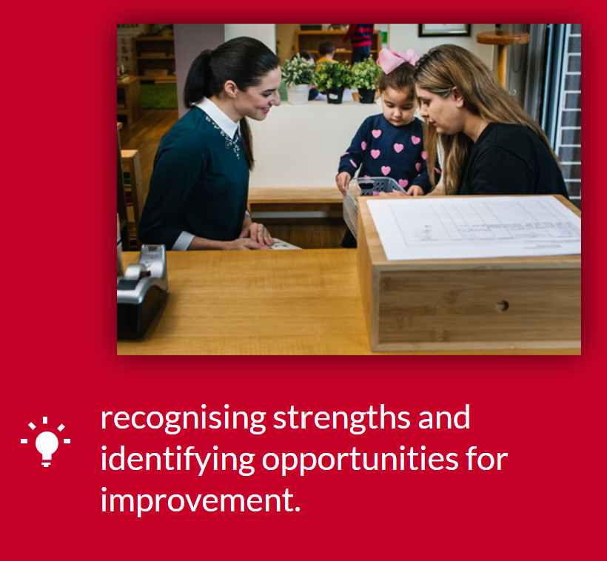
Self Assessment- what's in it?
Notes:
We have a very experienced marketing team that can provided marketing assistance

Slide 8
Self Assessment and your unique practices
Each Service is unique
The way in which you provide quality education and care to your children will be determined by your service context, including:
Your service environment
The needs, interests and abilities of the children attending your service
The needs of your families and the wider community
The Quality and quality improvement should reflect the service context and recognize the importance of your unique context.
There is no one approach to quality. In self assessment you can promote the unique culture and identities of the children and families of your service community.
Self assessment and quality improvement works best when all members of the service team, including staff, educators, children, families and members of local communities , collaborate and share.

Slide 9
Frequency of Self Assessment
When should self assessment occur?
Self assessment at the service should be ongoing, regular and planned.
A continuous cycle of review will help keep the focus on quality improvement. The cycle includes:
Assessing practice to review quality improvements that may be needed
Implementing those improvements
Reviewing the impacts of those improvements to identify further enhancements, if necessary.
Using a planned approach to self assessment involves:
Having a plan to regularly review all aspects of NQS
Keeping a record of what has been assessed and when that occurred.

Slide 10
Tools for reflection on quality practice
Service programs and practice are to be reviewed for:
Effectiveness of practice for all children and families
Relevance of the practice to the service and your children, families and communities.
Equity and Fairness of the practice for all children, families and educators.
Consistency with the service philosophy.
Reflection of the practice will help:
Assess current practice
Identify strengths
Identify areas for improvement
Critically reflect on how your service achieves quality outcomes for children and families
Share your service practices with your children and families

Slide 11
QA 1 Educational program and practice
Quality Area 1 focuses on ensuring that the educational program and practice of educators are child­ centered, stimulating and maximize opportunities for enhancing and extending each child's learning and development. It recognizes that a quality program that builds on children's individual knowledge, strengths, ideas, culture, abilities and interests is likely to have long-term benefits for children and for the broader society.
1.1.1 Approved learning framework | Is the curriculum designed in accordance with NQS? Is the curriculum designed current and relevant? How? (inclusion of event calendar, child initiated experiences), Are the resources provided enough? (variety and age appropriate), Are the resources provocating curiosity?
 | Is child’s identity being valued? How? Do you celebrate milestones, recognize failures and work out strategies, celebrate birthdays and other important achievements? Do you assess children’s learning through EYLF outcomes and practices?
 | Is child’s mental and physical wellbeing well thought of? How? Is physical wellbeing demonstrated through positive role modelling such as hand washing, sneeze into elbow, regular rigorous physical activity, healthy eating? Mental wellbeing through comfort and secured environment, intentionally teaching social and moral values, positive demonstration of magic words of thank you, sorry and excuse me. Is the child happy and relaxed in your environment, if yes, how? (look for cues such as smiles, cuddles, seeks comfort in your arm)
 | Are there enough opportunities for community engagement? Incursions/ excursions? Playgroups? Regular park visits? Farm?
 | Are children’s voices heard? Are there any child initiated activities included in the program? Are families consulted to learn more about their background, culture, ethnicity, language?

Slide 12
QA 1 Educational program and practice
1.1.2 Child centred | Do you follow inquiry based curriculum? How is the balance between educator led and child initiated activities sit in your program? Is it documented?
 | Are the families consulted for the kind of celebrations they do at home, festivals they celebrate, food they cook and eat, traditions they follow? How often are families informed about child’s progress, learning? Is parent’s feedback requested on the observations and learning stories?
 | Is the program modified based on child’s interest? Is anyone forced to follow routine or educational experiences? Is there a good mix of all skill sets in your program? Are the experiences repeated for better retention?
1.1.3 Program learning opportunities | Is the planning cycle followed? Is the “reflect” part of planning cycle documented? Is future plan mentioned for previous program is incorporated in next program? Are those experiences repeated to see the progress? Is it documented in form of reflection and observation?
 | Is there is a good mix of planned and spontaneous opportunities? Are routines structured in a fun way? (in form of song for packing the mess or washing the hands) or a timer and race to pack up mess?
 | Are routines embedded in program or changed frequently? How are routines explained to new children and families? Are routines made innovative to seek and maintain children’s attention?

Slide 13
QA 1 Educational program and practice
1.2.1 Intentional teaching | Do you follow positive role modelling? Do you “listen” to children? Are you available for children?
 | Do you give freedom of choice? If yes how? How do you differentiate between good choices and bad choices and how is it communicated?
 | How do you communicate with children? Is it respectful? How is your non verbal communication? For example your body language? Do you get irritated when children make mess? What are your self regulation strategies with children?
1.2.2 Responsive teaching and scaffolding | Do you maintain children’s agency? Do you sit with children? Do you eat with children? Do you draw with them? Do you participate in the fun games with children?
 | How do you resolve conflict between children? Is it just by saying no or do you tend to give examples or share stories to prove a point?
 | Are there group learning opportunities available? If anyone chooses not to participate what is usually your approach? How do you try to include that child in group without forcing him to participate? (ask him to be around the same room, keep talking to him/her)
1.2.3 Child directed learning | Are children provided with freedom of choice? Do they have access to all the resources? Is free exploration leading to a meaningful learning journey?
 | Are you flexible to modify your planned experiences to accommodate spontaneous ones? If yes, are they documented?
 | Are there any experiences which can engage children of all age groups? (park visits where there is something for everyone)

Slide 14
QA 1 Educational program and practice
1.3.1 Assessment and planning cycle | Is planning cycle being followed? Is the last program linked to next one? Are individual observations derived from the group program? Is there is a link between group program and individual observations for the same period?
 | How often parents are informed about child’s progress? Is there any individual development plan for a particular child? Are the needs of each child clearly recognized and specified? Do you consult specialist who might be helping a child with special needs for strategies? Do you document the progress to provide report to parent?
 | Do photos videos and learning stories correspond to the program? Are families involved in the planning?
1.3.2 Critical Reflection | Are there any areas for improvement? If yes, how are they assessed? Is the coordinator being consulted? Are there any resources that are searched and obtained? Is family involved?
 | What are your strengths? Why do you think they are your strengths? Do Group reflections include “what did not work well” part? If yes, what strategies are implemented for inclusion?
 | Are there any barriers for inclusion? If yes what? Is it culture, language or the environment is not welcoming? Are you providing the required engagement? (through communication/ participation etc)
1.3.3 Information for families | Are families invited into your environment for celebrations? Cooking? On excursions?
 | Are families getting contacted for information sessions/ training or professional development opportunities/ meet n greet, community based projects?
 | Do you seek parent feedback in writing? Are there surveys available that are sent out to families? Are any complaints or suggestions taken into considerations? How are families informed that their feedback is been heard and changes have been made?

Slide 15
QA 2 Children’s Health and Safety
Quality Area 2 reinforces children's right to experience quality education and care in an environment that provides for their health and safety. Educators support this when they promote each child's wellbeing and healthy lifestyle, and support each child's growing competence, confidence and independence.
2.1.1 Wellbeing and comfort | Is the environment comfortable for child to belong and become a part of it?
 | Are safe sleeping practices followed? (SIDS n KIDS), beds, cots, mattresses comply with Australian standard safety requirements? Are there quiet activities available for children to engage in? Do you have a quiet corner? How do you guide children’s behavior with regards to respecting each other’s need to relax?
 | Do you allow comforter or dummy? How are school children being attended to when toddlers and babies are sleeping? How do you manage different sleep times?
2.1.2 Health practices and Procedures | Do you have a child with action plan? Is the action plan displayed in the environment? Is it checked regularly for review date? Are children and parents aware of the allergy and potential risk? Do you have a copy of RMP and CP, extra copy in emergency bag? Does a parent have a copy? Is it up to date?
 | Do you have a COVID safe plan? What are some of the precautions that you regularly take with regards to being safe during pandemic? Do you have hand washing and nappy change posters? Do the children recognize and follow the steps?
 | Are illness and injuries documented? Are parents made aware of the injuries and illness? Does the coordinator being informed? Do you assess the risk before and after the incident and are there any extra measures reinforced? Do you have an updated copy of risk minimization and communication plan? Is your excursion plan up to date? Do you follow the guidelines mentioned in the risk minimization plan?

Slide 16
QA 2 Children’s Health and Safety
2.1.3 Healthy Lifestyle | Is there a good balance of indoor and outdoor activities for children? How often are physical activities promoted? (give examples)
 | Do you promote healthy eating? How do you communicate parents the importance of healthy lunch box? Do you positively role model healthy eating? Do you provide morning/ afternoon tea? Is it usually consisting of fruits/ veggies?
2.2.1 Supervision | Are children being supervised all the time? Do you apply peripheral vision and being alert strategies when supervising children? Are you aware of sleep time supervision requirements? Are you aware of duty of care?
 | Do you have a copy of risk assessment plan? Are you aware of all the clauses listed in the plan? Do you follow a daily safety checklist? Is it reviewed frequently?
 | Meal time supervision especially the children with allergies and intolerances are practiced effectively? Do you know how to use Epi pen if needed? Do you know how to use fire extinguisher and fire blanket?
2.2.2 Incident and emergency management | Is daily safety checklist followed every morning before children arrive?
 | Are the action plans renewed on time and a copy is received and updated? Are you aware of the food safety guidelines?
 | Are the enrolment forms up to date? The emergency contact details are current? Are you aware of bush fire risks? Do you have a list of emergency contact numbers handy? How often do you practice emergency evacuation drills? Do you know the emergency evacuation and assembly point?

Slide 17
QA 2 Children’s health and safety
2.2.3 Child Protection | Are you aware of child protection laws? How frequently do you engage yourself in professional development training with regards to child protection? Can you recognize types of abuse and symptoms?
 | Are you aware of child safe standards? Do you actively promote inclusion of aboriginal and Torres strait islander children? Do you have any families with aboriginal heritage? How often do you engage yourself in the aboriginal community? Do you have access to any resources? Do you follow and teach “acknowledgement to the country” in your environment?
 | Do you update your knowledge about disabled and trauma affected children? Do you engage in any professional development training with regards to CALD community?

Slide 18
QA3 Physical environment
Quality area 3: The physical environment is safe, suitable and provides a rich and diverse range of experiences which promote children's learning and development.
3.1.1 Fit for purpose and 3.2.1 Inclusive environment | Are the indoor and outdoor spaces designed as per children’s needs and age? Are all furniture and equipment of appropriate size and at children’s eye level?
 | Do the resources stimulate learning opportunities? Do children have easy accessibility to resources? Are they in enough quantity? Do the resources and environment lead to provocations? Do the children know how to use the resources? Do you have any open ended resources such as loose parts? Do you allow children to bring toys from home?
3.1.2 Upkeep | Do you provide variety and vibrancy through the resources and environment? Can the resources be manipulated for multiple use?
 | Is the environment clean, neat, tidy, free of rust/ dust? Are all broken/ rusty toys checked and replaced regularly? Do you follow a regular washing cycle for bed linen, dress ups, toys that are mouthed ? Are you following Covid safe hygiene practices? Are your outdoor spaces free of clutter and animal feces?
3.2.2 Play based learning and 3.2.3 Environmentally responsible | Are you following sustainable practices in your service? If yes how? (give examples) Do you engage children in gardening? Do you engage children in local community events such as local park cleanliness drive? Do you make use of local flora, fauna, local produce, native trees/ birds/ animals in your educational program? Do you support “walk to the country” drive?
 | Do you use natural material? Do you consider and follow “environment as third educator”? Do you follow 3 Rs policy?
 | Do you have open ended resources? Are the resources being manipulated in multiple ways at the moment? How could you put the resources to best use?

Slide 19
QA 5 Relationships with Children
Quality Area 5 focuses on educators developing responsive, warm, trusting and respectful relationships with children that promote their wellbeing, self-esteem, sense of security and belonging. Relationships of this kind encourage children to explore the environment and engage in play and learning.
5.1.1 Positive educator to child interactions | Do you demonstrate respectful communication towards children? How? (use of magic words, politeness, manners) Do you use active listening skills when children are asking questions? Are you mentally and physically available for children? Is your non verbal communication effective and demonstrates positive vibes? Are children feeling and appearing safe and secured and they are not afraid of making mess or exploring the environment or even simply asking questions?
 | Do you value and consider children’s and parent’s opinions? Do you give opportunities to children to express, debate, lead, try and take responsibility for their own behavior?
5.1.2 Dignity and rights of child | Awareness of child safe standards and safe environments? Are you aware of UNCROC? Do you have posters displayed in your environment about child safe standards and convention?
 | Do you promote children’s agency through positive relationship and scaffolding? Is equity and diversity embraced through inclusive ways? (give examples) How do you guide children’s behavior especially with someone demonstrating challenging behavior? What strategies do you apply for inclusion?

Slide 20
QA 5 Relationships with Children
5.2.1 Collaborative learning | Is the environment inclusive? Is there something for everyone? How do you showcase positive role modelling towards sharing? Do you plan a daily group time?
 | Do you provide verbal and non verbal encouragement? Do you engage children in risky play? Do you instill confidence to try new things and explore freely? Do you maintain a good balance between the planned intentional experiences and child initiated activities? Are the resources arranged gender specifically? If yes how could it be avoided?
5.2.2 Self regulation | Do you demonstrate positive role modelling to embed good social and moral values? Do you intentionally teach the social etiquettes and norms?
 | How do you guide children’s behavior especially with someone demonstrating challenging behavior? What strategies do you apply for inclusion? Do you know how to identify the triggers for aggression? Do you know the strategies to recognize the “need” behind such behavior? Do you undertake any professional development opportunities to keep yourself up to date?

Slide 21
QA 6 Collaborative partnerships with families and communities
Quality Area 6 focuses on supportive, respectful relationships with families which are fundamental to achieving quality outcomes for children. Community partnerships that are based on active communication, consultation and collaboration also contribute to children's inclusion, learning and wellbeing
6.1.1 Engagement with service and 6.1.3 Families are supported | Are the parents familiar and comfortable with enrolment process? Do they know the service admin team details and the customer engagement officer contact details? Are the parents aware of the different forms such as booking form, change of details form etc? Do they need assistance with technology or language?
 | Are the parents receiving a copy of newsletters, policy changes and other important announcements? Do they need assistance with understanding the billing cycle/ CCS? Are the parents aware of the support services such as early intervention, family violence, disability provided by Windermere?
 | Do parents receive online communications in form of children’s observations and educational programs in timely manner? Are parents involved in any community events or celebrations at center or for any networking opportunities?
6.1.2 Parent views are respected and 6.2.2 Access and participation | Are the parents invited into the environment to observe, assess and contribute their opinions? Are parents feedbacks and suggestions considered? How are these communicated to parents?
 | Is there a communication/ discussion about the diverse environment that might be there at home and ways to be more inclusive at center? Are parents involved in celebrations such as birthdays, festivals, end of year get together?
 | Are the routines adjusted to accommodate parent’s views and ways of being? Are cultural considerations taken into account?

Slide 22
QA 6 Collaborative partnerships with families and communities
6.2.1 Transitions | Is continuity maintained wherever possible to transition the child from one space to another or from one routine to another? Are routines designed in a way to accommodate changes easily? Is toilet training a relaxing and comfortable experience for the child? The timeline decided for the transition is done in consultation with the parents? Could the timeline be adjusted depending on each child’s situation?
 | Have you made the parents aware of the stages of transition? Have you taken their opinions into considerations? Are their any barriers to transitions? If yes, have you asked a parent to help? Have you consulted a coordinator for support? Are any trainings/ resources researched for support?
6.2.3 Community engagement | Do you have regular incursions and excursions? Are they pre planned and parents have made aware of these? What factors do you consider when choosing an excursion? Do you attend play groups?, if yes why? Do you like doing play dates with other educators? Do you engage with educators from other service for brainstorming?
 | Do you keep yourself up to date with local community and council events? How often do you engage children and families in any social/ cultural/ linguistic event?
 | Are you member of any community groups? Do you initiate any drives such as cleanliness drive in local park? Do you support and actively participate in any cause such as sustainability awareness? Wheelchair recycling project? Wildlife conservation drive?

Slide 23
Questions

Slide 24
Thank You!

