Slide 1
Observations, Documentation and Reflections

Slide 2
Acknowledgement to the country
We acknowledge the traditional owners of the land where we reside and work in paying respects to the first people on whose land we are, acknowledging the loss of lands, cultures and treasures, knowing the consequences for people, communities and nations, believing that we can work together to a better future

Slide 3
5 Reasons to observe children
If I watch children play, I discover their interests
By observing children, I can assess their developmental levels
I look to see what strategies children use to attain their goals
Observing children helps me know what skills the children need to practice
When I observe children play, I learn a lot about their personalities (Forman & Hall, 2008)

Slide 4
Observational Records
Running record
Anecdotal record
Work samples
Photographic record
Jottings
Learning Story

Slide 5
Interconnectedness
Program
Planned and Spontaneous Experiences
Assessment via observation
Documentation

Slide 6
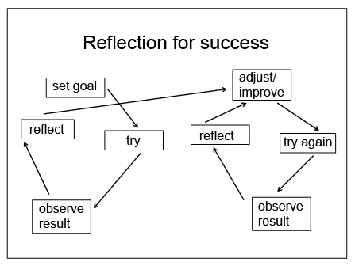
What are we looking for?
Children’s strengths - What they already know and can do
Their needs - What they need to know and do
Their potential - What they have the potential to know and do
Their interests - What they want to know and do

Slide 7
How to document?
Observations have 3 sub parts-
Observation-
Actual details are recorded of what is been seen, heard, talked and happened. Any conversations that happened are documented here.
Interpretation-
Educator’s analysis of what the child is learning, assessing the development, the skills demonstrated and connection to EYLF outcomes and practices.
Future plan-
Based on the current observation and educator’s analysis what could be offered next to the child to extend the learning. This should be assessed during the next group plan.

Slide 8
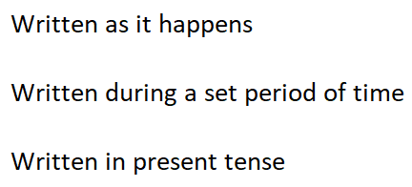
Running Record

Slide 9
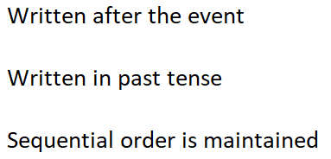
Anecdotal Record

Slide 10
Photographic Record

Slide 11
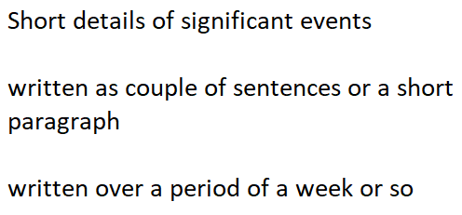
Jottings

Slide 12
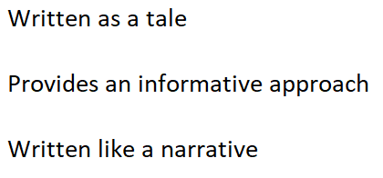
Learning Story

Slide 13
Jo-anne Napoleon (Running record)

Slide 14
Connie Meunier (Photographic record)

Slide 15
Alicia Anderson (Learning Story)

Slide 16
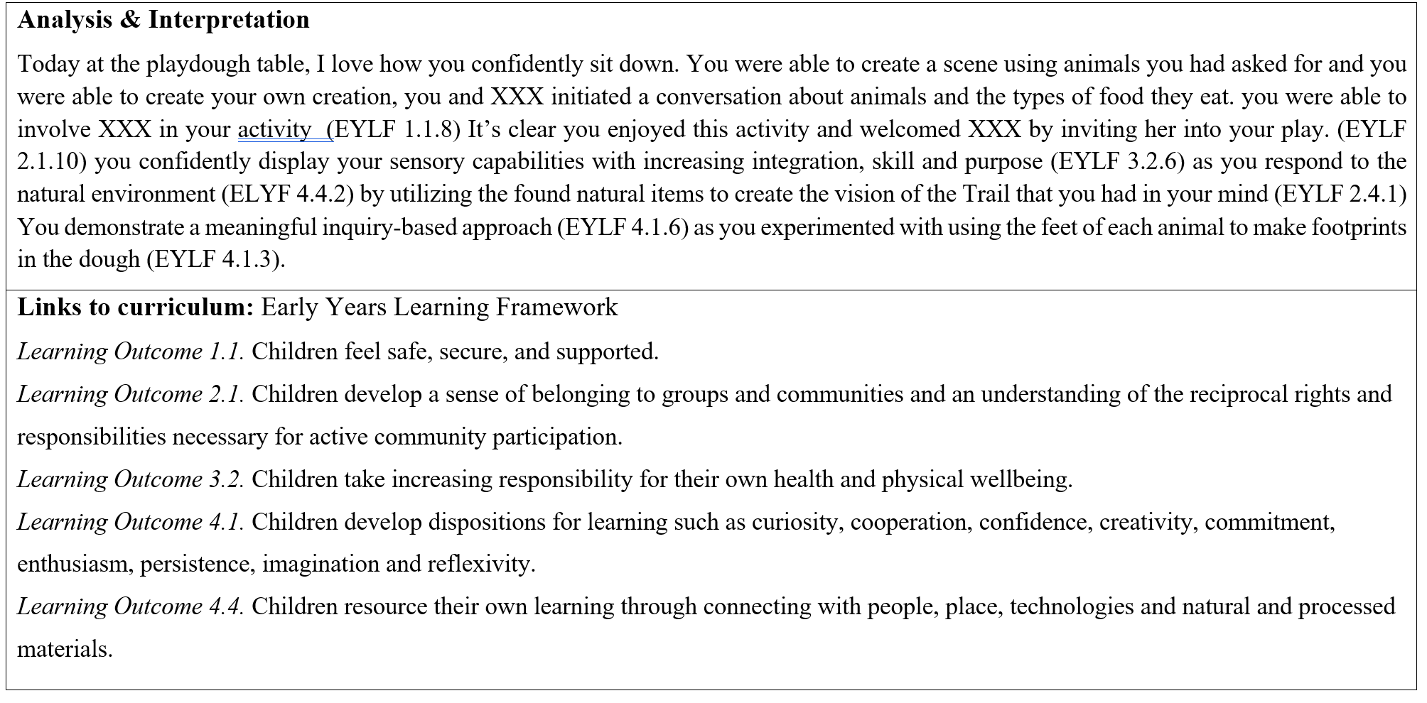
Alicia Anderson (Learning Story continues)

Slide 17
Thank you!!! Questions???

